Slide 1
Computational Style Sheets

Slide 2
Numbering Nodes
Number nodes using:
<xsl:number>
position()
Using position():
Nodes are numbered by position in result document
Can be used in conditional statements
Notes:
You used position in lab yesterday
Hierarchical list – level=“multiple”
Formatting numbered list = format=“A”
Grouping=“2”

Slide 3
Using <xsl:number>
Nodes are numbered according to position in source document
Attributes:
value=expression: any XPath expression that evaluates to a number (i.e. position())
count=pattern: specifies which nodes to count
level=type: tree level for nodes to count; can be any, single, or multiple
from=pattern: pattern indicates where numbering should restart
format=pattern: pattern indicates number format
grouping-size, grouping-separator: indicate how digits are grouped and separator character
Notes:
Show fireworks
Count=“fountain | rocket

Slide 4
Context XPath: not just for navigating nodes in an XML document
Contains over 200 built-in functions!!
Notes:
What kind of functions you ask?

Slide 5
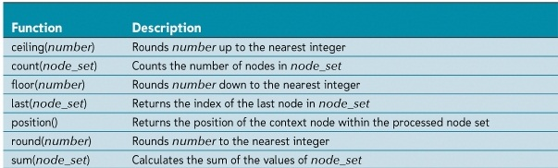
XPath Numerical Functions
Used to calculate numerical values or manipulate text strings
Numerical functions:
Notes:
Not unfamiliar to functions like those used in spreadsheets….

Slide 6
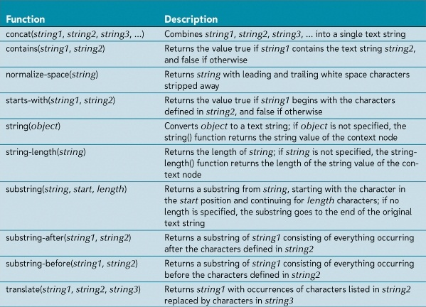
XPath Text Functions

Slide 7
Text Nodes and White Space
White space:
Space devoid of any printable character
Space, tab, new line, carriage return
Adjacent <xsl:value-of> elements will have results combined to eliminate white space
<xsl:text> can be used to create white space:
Syntax: <xsl:text>Text</xsl:text>
Can only contain literal text

Slide 8
Controlling White Space
Stripping space:
Remove text nodes from the result document that contain only white space
Syntax: <xsl:strip-space elements=“pattern”>
Use * as pattern to match all nodes
Preserving space:
Make sure that text nodes that contain only white space are not deleted
Syntax: <xsl:preserve-space elements=“pattern”>
Use * as pattern to match all nodes
Normalize space:
Remove leading and trailing spaces
Syntax: normalize-space(text)

Slide 9
Copying
<xsl:copy>
Syntax: <xsl:copy use-attribute-sets=”list” />
Shallow copy: only node itself is copied
<xsl:copy-of>
Syntax: <xsl:copy-of select=“expression”/>
Deep copy: node and descendants are copied

Slide 10
Context XPath: not just for navigating nodes in an XML document
But wait there’s more!
Where can I use this wonderful product?
Notes:
Where can I use this wonderful product?

Slide 11
XPATH: it’s everywhere you need it to be
XPATH is not going away, it’s widely used in a variety of languages and remains as one of the most concise ways of dealing with XML documents
XSLT
JavaScript
Java
PHP
Python
C#/.NET
Notes:
Time for the XPATH quiz/exercise (see examples folder)

